Slide 1
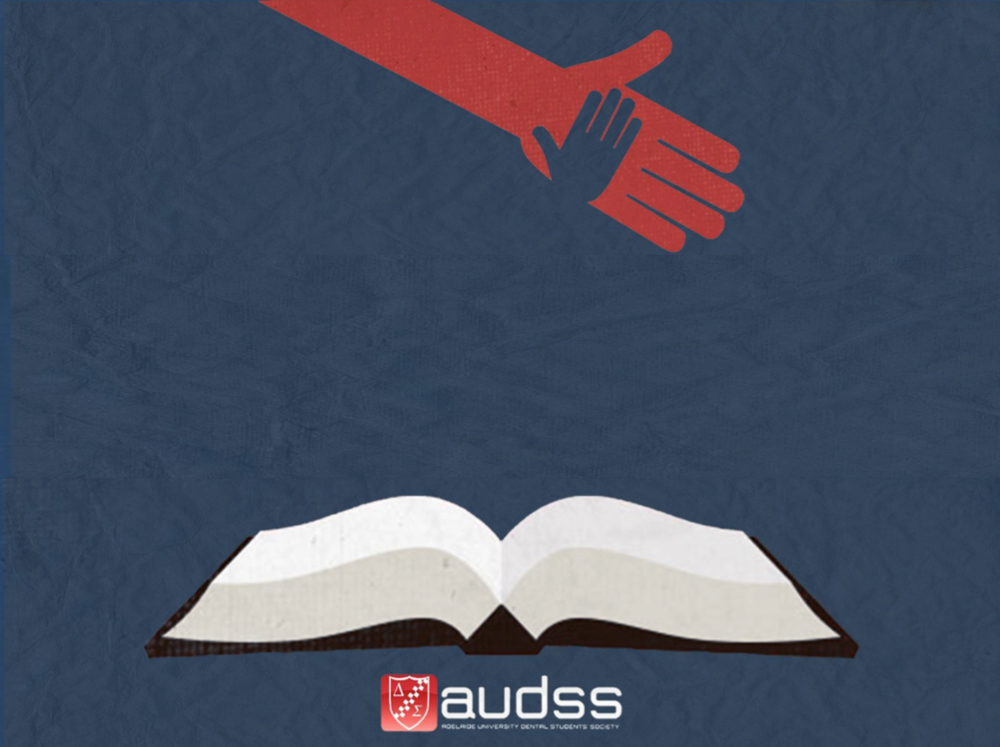
GROUP AND INDIVIDUAL LEARNING: BDS 4 EXAM PREP AND QUESTIONS

Slide 2
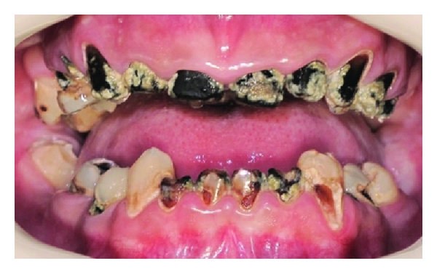

Slide 3
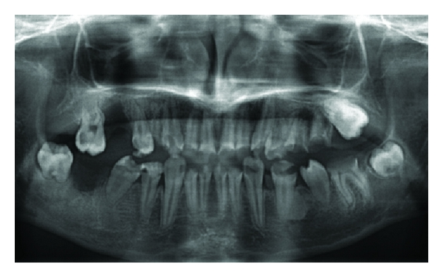

Slide 4
Mrs Smith
Mrs. Smith attended on Friday for the extraction of 47. You read your notes which say :
  LA, Closed extraction of 47, Haemmostasis achieved, POIG
It has been 5 days and Mrs. Smith returns to the practice complaining of pain on the lower RHS of the jaw.
  What tests would you do ?
  What further questions would you ask ?
  List of Differential diagnoses

Slide 5
Medical History Questions
Mr. Jones has recently been diagnosed with diabetes but has not begun to take medication for this.
  What might you expect to see in the mouth ?
    Translation : Patient is an uncontrolled diabetic. What are the oral manifestations of this?
What other information do you need?
As you begin your examination his hands have started to shake and you can see a film of sweat on his forehead. What is the likely cause? How will you manage this patient now? If you check his blood sugar now how much is it likely to be?
Mr. Jones attends 6 months later( he now takes meds, is feeling much better) → What information do you need to know? Whats should his BGL/ BSL be? How much should it be in a healthy/ non-diabetic individual/

Slide 6
Standard Medical History
The conditions and medications will most likely be from Therapeutic Guidelines, ILA or something they’ve covered heavily with OMS.
Things to know well:
  Dental implications
    Effects on general health
    Dry mouth
    Inflammatory response
    Immunosupression
    Allergy
    Interactions with dental products ( e.g. LA and MAOIs)
  Any medications
  Further questions: Condition or medications
  Futher information : Condition or medications ( e.g. dose of meds, how long, why?)
  Any tests: CTX, INR, Allergy tests, Biopsy
  Oral manifestatons of systemic disease
  How will this affect your treatment plan:
    Delay extractions
    Local measures
    Cant prescribe penicillin ( allergy) or metronidazole ( interactions: Warfarin)

Slide 7
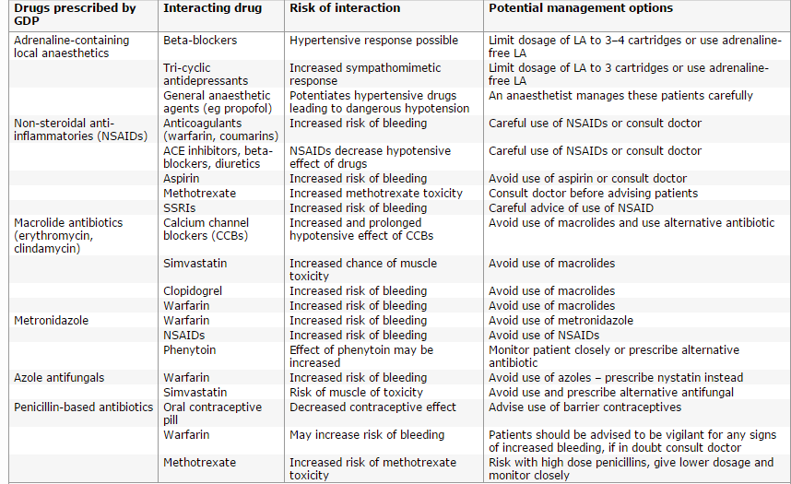
Drugs

Slide 8
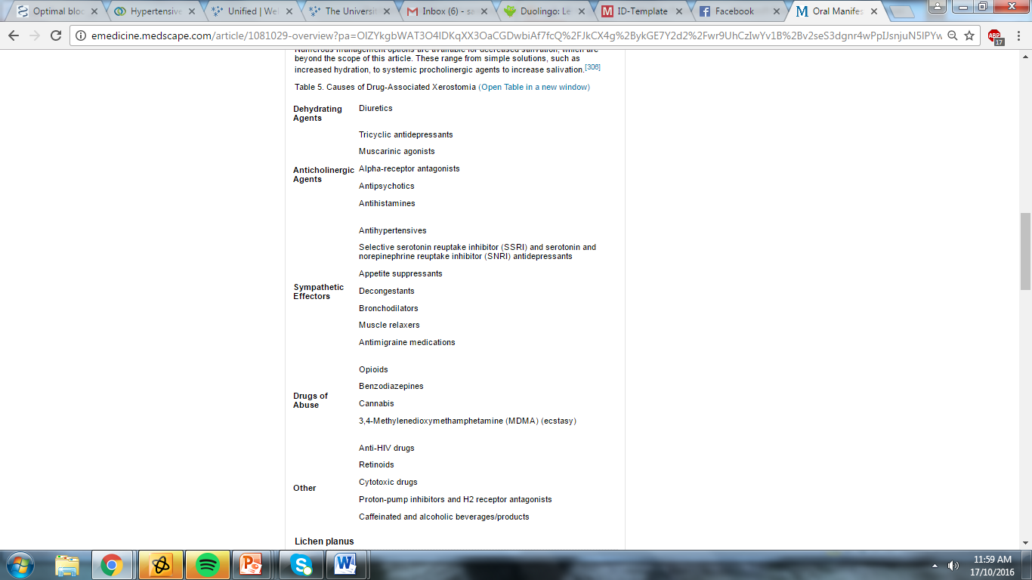
Drugs that cause Dry mouth ( revision from 1st Semester)

Slide 9
Oral Manifestations( Examples)
Use this link: http://emedicine.medscape.com/article/1081029-overview?pa=OlZYkgbWAT3O4lDKqXX3OaCGDwbiAf7fcQ%2FJkCX4g%2BykGE7Y2d2%2Fwr9UhCzIwYv1B%2Bv2seS3dgnr4wPpIJsnjuN5lPYw%2FtQ7Z8WOOzpssmw%3D
GIT Disease ( Reflux)- Associated with nonspecific burning oral sensation, mucosal erosions and ulcerations, halitosis, and both xerostomia and hypersalivation. Dental: Enamel erosion
Thrombocytopenia: petechiae and ecchymoses may be visible on the soft palate and buccal mucosa.^{[41]} Gingival bleeding is common and often spontaneous.^{[41]}Hemorrhagic bullae that appear as deep‒red-to-violaceous or black blisters may appear on mucosal surfaces in cases of severe thrombocytopenia

Slide 10
More Oral Manifestations
Sjögren syndrome: saliva can be thick, ropey, or absent. Mucosal changes : Dry, red, and wrinkled mucosa and a cobblestone like appearance of the tongue( papilla atrophy ) Candidiasis and Increased incidence of dental caries is also seen in SS
Diabetes:
  Mucosal manifestations :fissured tongue, benign migratory glossitis, coated tongue, irritation fibroma, traumatic ulcers, and recurrent aphthous ulcers
  Salivary dysfunction, with or without signs of salivary gland enlargement, burning mouth syndrome, and taste disturbances are also common in diabetes, likely owing to secondary neuropathy.
  Diabetic individuals are also at an increased risk for oral fungal infections, specifically candidiasis.
  Dental caries, periodontitis, and gingivitis are also more common in persons with diabetes.

Slide 11
Fixed Prosthodontics
Case Selection : Discuss Fixed Prosthodontics as a treatment option but focus on the risks of failure ( e.g. why it may not always be the best treatment option in the provided case)
Crowns
    Patient
      General health
      Causes of dry mouth, poor oral hygiene, likely causes of failure
    Mouth
      Oral hygiene
      Opposing restorations
      General occlusal scheme
      CR and CO
      Number of remaining teeth
      Types and sizes
      Bruxism
      Wear patterns
    Tooth
      Amount of tooth structure remaining
      Perio status
      Endo status
        RCT or no RCT
      Crown-root ration
      Restorative status
        Type
        Size
        Material

Slide 12
Example
Mrs Black presents to you for dental treatment with a chief complaint of loose upper denture. She is 64 year old lady who has mild asthma and osteoarthritis. She carries a Ventolin puffer, takes Zantac for a peptic ulcer and is on hormone replacement therapy and calcium. Her 8 year old acrylic partial upper denture has fractured several times across the palate and been successfully repaired. She has the following teeth:
Upper 7 5 3 1 1 2 3
Lower 8 6 5 4 3 2 1 1 2 3 4 5 7
She has generalised 4 mm periodontal pockets with some bleeding on probing.
Tooth 15 is by comparison to other teeth, quite grey and restored with an MOD amalgam which also replaces the palatal cusp. All posterior teeth are restored, as are the anterior teeth, which also show considerable incisal wear
There is shallow non carious tooth tissue loss at the buccal cervical of most teeth, in particular the lower premolars; these teeth are not sensitive to touching with a probe.

Slide 13
Questions

Slide 14
Example 2
Mr David Roberts is a 65-year old man who presents with a failed two unit PBM cantilever bridge with a crown on 22 supporting 21 pontic. The bridge is three years old, but one year ago the 22 crown fractured off at the cementoenamel junction. Repair was attempted by cementing a titanium Parapost in the root canal and re-attaching the 22 bridge retainer with Luxacore composite resin. This repair has now failed and Mr Roberts is very upset as he says he was told the bridge would last 10 years.
MHx Clear and Oral hygiene is good. The OPG and periapical film was taken one year ago after the first repair. Photos 1 show the failed bridge and the appearance of the 22 and the edentulous ridge.
David asks you to examine all his teeth and ‘fix them up’ so that he has no more problems in the foreseeable future. The only difficulty relates to a time constraint, as David is going to Europe at the end of the week for 3 weeks and requests that priority be given to the 21, 22 area.

Slide 16
Think about treatment options for this patient

Slide 17
Treatment Decisions and Options
Extract 22 or Keep 22- consider prognosis
  When will you extract 22 ?
Choice of replacement
  Short-term
    He is leaving in less than a week
    Consider interim solution ( Post core and crown have been retrieved in one piece)
    Temporise and leave but explain poor prognosis and temporary nature
  Long- term
    Options include- Implants , RPD( acrylic vs chrome), Cast post core ( once again think about the prognosis), Leave
  Consider patient expectations

Slide 18
Key Features: Photograph
Type of picture: E/O, I/O, Frontal, Profile
Overall picture:
  Soft tissues
  Face shape
  Symmetry
  Proportions: increased or reduced lower facial height
  Gingival health- usual shit
Teeth:
  Teeth present (Obvious restorations)
  Occlusal scheme
  Obvious disease: Caries, wear, recession (note site), suppuration, obvious furcation involvement, draining sinuses
  Misalignment
  Discolouration

Slide 19
Follow Up questions
Aetiology or Differential diagnosis
  Discolouration
  Broken tooth/ filling
  Pain
  Oral Pathology ( although this didn’t really come up last year)
  Trauma ( avulsion vs intrusion)
Further tests
  Pulp test
  Percussion/ Palpation
  Probing / Mobility / Furc involvements
  Fract finder
  PA
  OPG
  Transillumination
  LA
  Test cavity
  Occlusion!!
  Think about the order in which you write it and what is most important ( but because its not MCQ you could technically write all the ones that are not too ridiculous)

Slide 20
Radiographs
OPG
  Comment on quality of R/G!!
  E/O: TMJ, oropharyngeal spaces, calcifications
  Any obvious bony pathology
  Bone levels- Horizontal and vertical
  Teeth:
    Obvious caries
    Obvious calculus
    PA radiolucency
    Furcation
    Teeth present

Slide 21
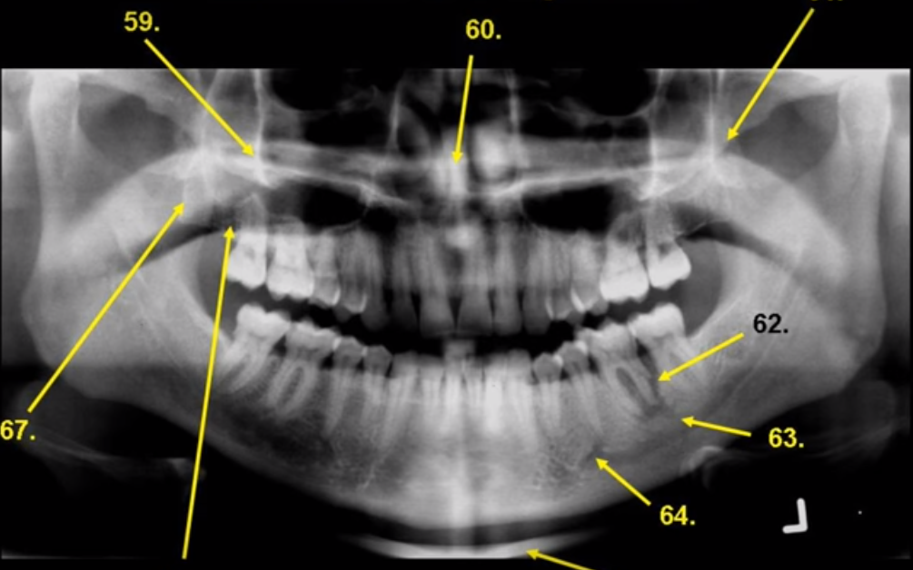
Example

Slide 22
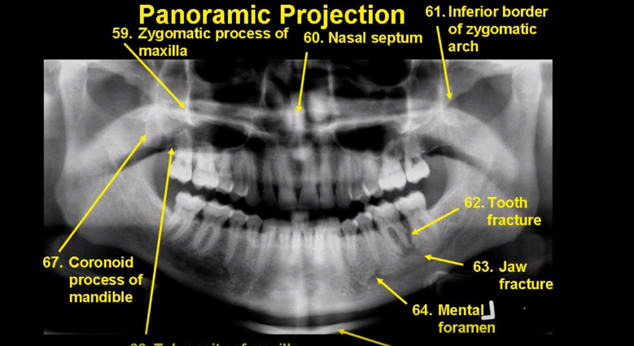

Slide 23
PA
Quality of R/G
Bone levels- horizontal and vertical
Crown
  Restorative status
  Obvious defects or disease
Calculus
Pulp chamber
  Anomalies / pulp stones/ pulp chamber obliteration
Root canal System - RCT (Including quality) / not , shape, calcified canals
Periapical region
  Lamina dura
  Widened PDL
  PA RL
  PA RO
Bony pathology

Slide 24
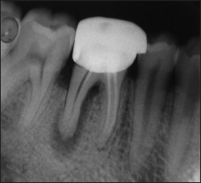
PA ( Example 1)

Slide 25
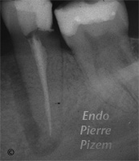
PA ( Example 2)

Slide 26
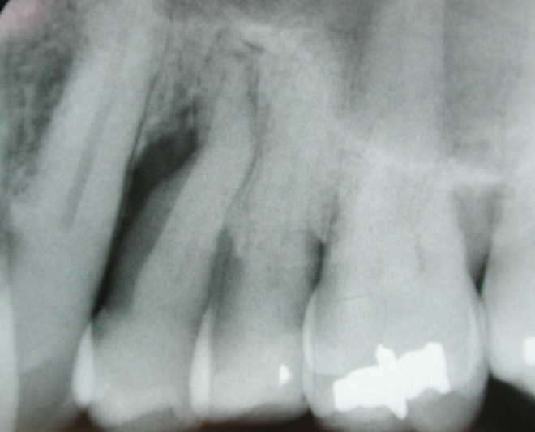

Slide 27
Perio Questions
Dr Jones is a recent graduate who detected a periodontal lesion (pocket) of 9mm at the mesial surface of 24 (see attached x-ray). The treatment options are:
  Subgingival root debridement (closed therapy)
  Gingivectomy
  Flap debridement surgery
  Guided tissue regeneration
Discuss the clinical outcomes for each of the procedure (10 marks)
What will be the treatment of choice here? (5 marks)
What factors may affect the final outcome of your treatment of choice? (10 marks)

Slide 28
Bitewing
R/G Quality
Bone levels- horizontal and vertical
Crown
  Restorative status
  Obvious defects or disease
Calculus
Pulp chamber
  Anomalies / pulp stones/ calcified canals
  RCT / not
Can comment on over eruption or occlusion if it’s obvious

