Slide 1
TRAUMATOLOGY

Slide 2
Commonwealth of Australia
Copyright Regulations 1969
Warning
This material has been reproduced and communicated to you by or on behalf of The University of Adelaide under Part VB of the Copyright Act 1968 (the Act).
The material in this communication may be subject to copyright under the Act. Any further reproduction or communication of this material by you may be the subject of copyright protection under the Act.
The AUDSS assumes no responsibility or liability for any information, materials or other content provided by any of our student lecturers. All content is viewed and used by you at your own risk and we do not warrant the accuracy or reliability of any of the lecture material.
The views expressed are those of the individual contributors and not necessarily those of the AUDSS of Adelaide School of Dentistry.
Do not remove this notice.

Slide 3
Tooth Discoloration
Red/Brown Discoloration
Trauma → rupture of blood vessels → extravasation of erythrocytes into pulpal space
Colour changes in the tooth:
Pink → yellow-pink → gray → gray-brown → gray-brown-violet
Haemoglobin or breakdown products
Return of tooth to normal colour = pulpal survival
Pulp does not return to normal colour = one sign of pulpal necrosis
Yellow Discoloration
Laying down of tertiary dentine following traumatic injury
Coupled with radiographic root canal stenosis
Indicates a vital pulp

Slide 4
Pulpal Diagnosis of Traumatised Teeth
Very important
- Over-diagnosis = unnecessary RCT
Failure to diagnose = untreated infection, loss of tooth structure to resorption, poorer long term prognosis
Regular followup and monitoring important for traumatised teeth
Often followup of up to 5 years recommended for traumatised teeth, can have late complications
Testing at followup visits includes: pulp testing, TTP, PA radiograph, etc.

Slide 5
Pulpal Diagnosis of Traumatised Teeth
Signs of Pulpal Healing
Transient apical breakdown: widening of the apical foramen to allow proliferation of blood vessels → Slight, well-defined RL: takes several months to resolve
Root canal stenosis: deposition of tooth structure in canal
Return of normal pulp sensibility: takes minimum of 4-6 weeks following traumatic event
Signs of Pulpal Pathology
Classic signs of pulpal necrosis + apical periodontitis: negative pulp tests, TTP, discoloration, apical R/L
Internal or external root resorption
Diagnosis of pulpal pathology made = RCT
Some conditions have poor prognosis (eg. Avulsion with closed apex) → start RCT prophylactically
* New technologies like the Laser Doppler evaluation: evaluation of pulpal blood flow (viability) using lasers, not commonly used in SADS

Slide 6
Root Resorption
Surface Resorption
Trauma to tooth → damage to cementum and cementoblasts
Cannot be detected radiographically (histologically only)
Self Limiting
Inflammatory Root Resorption
Internal inflammatory root resorption
Trauma to tooth → partial necrosis → inflammatory reaction of remaining vital pulp
Treatment = RCT (remove vital tissue causing resorption)
External inflammatory root resorption
Trauma → Injury to PDL + initiation of surface resorption → EIRR possible
Usually pulp is necrotic (infection present → inflammatory reaction against this)
Radiographically bowl shaped R/L on external root surface
Treatment = RCT with long term CaOH medicament (1-3 months)(remove source of infection)
* Prevention is key → RCT asap in avulsions, intrusion, severe luxation (closed apices)

Slide 7
Root Resorption
Replacement Resorption
Tooth structure replaced by bone that is fused to dentine (no PDL)
Often as a result of avulsion (loss of viable PDL cells due to extraoral dry time)
Ankylotic metallic sound on percussion
May have infraocclusion/incomplete alveolar process development (growing child)
No treatment, prevention important
Flexible splinting over rigid splints
Treatment of root with Fluoride or Tetracycline prior to replantation can slow replacement resorption
TAB
- widening of the apical foramen to allow proliferation of blood vessels → Slight, well-defined RL: takes several months to resolve

Slide 8
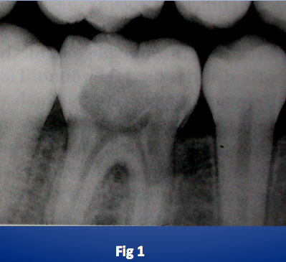
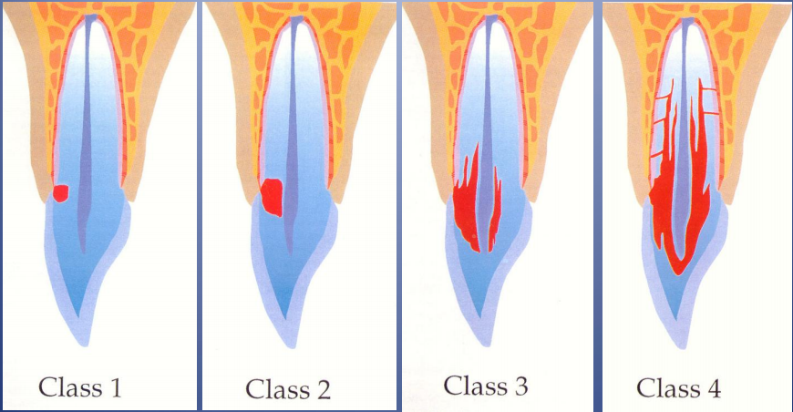
Root Resorption
Invasive Cervical Root Resorption
Classified as Hyperplastic resorption (external root resorption), very destructive
Pink spot on tooth, can present with gingival swelling (overlying infection)
Pulp responds normally to pulp vitality testing
Histology: Early lesions (Class 1 and 2) are fibrovascular, later lesions (class 3 and 4) are fibro-osseous
Differentiation from root caries: Radiographically a well defined R/O line surrounds the pulp (predentine + dentine barrier)
Predisposing factors: Trauma (damage to cementum), Intracoronal bleaching, orthodontics
Tmt (Class 1-3): 90% TCA, curettage, restoration with GIC, possible RCT

Slide 9
Apexification vs. Apexogenesis
Both have to do with affected teeth that have open apices
Apexogenesis
Vital pulp therapy to encourage complete development of incomplete root end
Can include treatments like pulp capping and pulpotomies with MTA or CaOH
Indications: luxation injuries, complicated fracture (pulp exposed), carious pulp exposure
Cannot be done with necrotic pulp
Apexification
Method of inducing calcified barrier at the apex of a non-vital tooth with incomplete root formation
Important because RCT with opex apex is very difficult
Can use CaOH or MTA to induce calcific barrier
* High incidence of root fracture following apexification (tooth has very thin dentinal walls, restorative treatment should aim to strengthen immature root)

Slide 10
Healing following Root Fracture
Healing by calcification
Healing with interproximal connective tissue
Healing with interproximal connective tissue and bone
* Non healing root fracture = presence of interproximal inflammatory tissue
Important to recognize the difference between healing and non healing root fractures using clinical signs + symptoms an radiographic findings

Slide 12
Management of Trauma in Permanent Teeth
Main Goal = Long term preservation of tooth if possible

Slide 13
Concussion
DIAGNOSIS
Tooth is TTP, nil displacement or mobility
Pulp testing – usually +ve
Radiographically normal appearance
TREATMENT
Not needed, monitor for 1 year
Clinical and radiographic control follow ups at: 4 weeks, 6-8 weeks, 1 year
PATIENT INSTRUCTIONS
Soft food: 7 days
Good OH: brush with a soft toothbrush after every meal, 0.1% CHx gel topically bds 1/52 (if good toothbrushing not possible in the area)

Slide 14
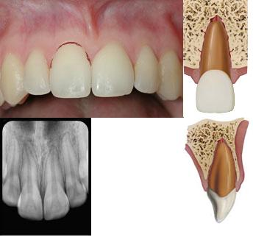
Subluxation
DIAGNOSIS
No displacement, but TTP and increased mobility
Bleeding from sulcus may be evident
Pulp testing – may be negative initially (indicates transient pulpal damage) → monitor
Radiographically normal appearance
TREATMENT
Not needed, monitor
Can place flexible splint for 2 weeks for patient comfort (if very mobile)
Clinical and radiographic control follow ups at: 2 weeks, 4 weeks, 6-8 weeks, 6 months, 1 year
PATIENT INSTRUCTIONS
Soft food: 7-10 days
Good OH: brush with a soft toothbrush after every meal, 0.1% CHx gel topically bds 1/52 (if brushing not possible)

Slide 15
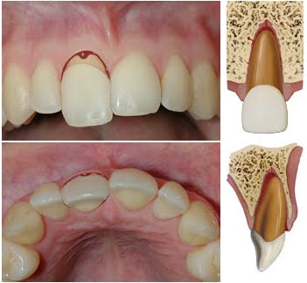
Extrusion
DIAGNOSIS
Tooth appears elongated, TTP, and excessive mobility
Pulp testing - unless minor, usually -ve.
Radiographically increased PDL space apically
TREATMENT
Reposition, LA usually not necessary
Stabilise for 2 weeks with flexible splint
Radiographically - open apex: can monitor, look for continued root development, +ve pulp testing. Closed apex: monitor
In closed apices where necrosis is anticipated, or where there are signs and symptoms consistent with pulpal necrosis → RCT
Follow-up: 2 weeks, 4 weeks, 6-8 weeks, 6 months, 1 year, 1 yearly for 5 years
PATIENT INSTRUCTIONS
Soft food: 7-10 days
Good OH: brush with a soft toothbrush after every meal, 0.1% CHx gel topically bds 1/52 (if brushing not possible)
*Immature teeth: revascularisation usually occurs; mature teeth: may occur

Slide 16
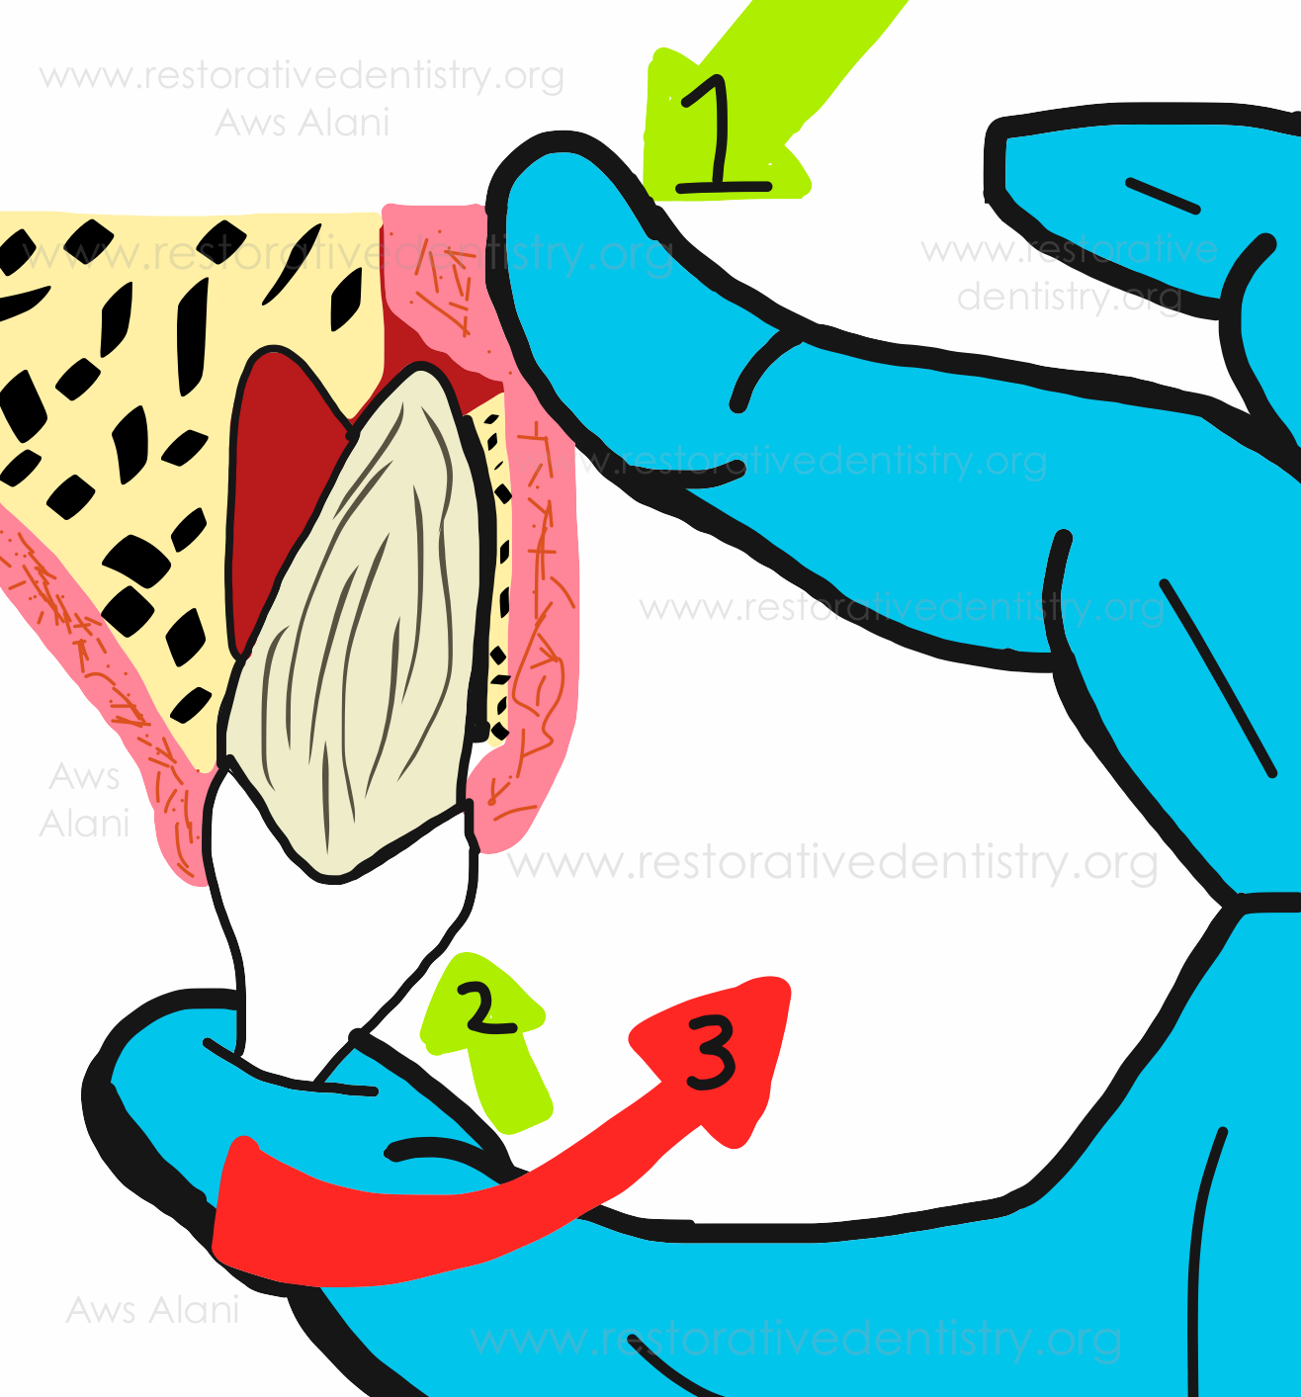
Lateral Luxations
DIAGNOSIS
Tooth displaced from socket, usually in palatal or labial direction
High metallic (ankylotic) sound to percussion, usually nil mobility
Alveolar bone accompanying fracture, tooth is usually either protruded/retruded
Pulp testing - usually -ve.
Radiographically increased PDL space (best seen on eccentric or occlusal radiographs)
TREATMENT
Reposition using forceps or digitally, disengage from bony lock, gently reposition into original position
Stabilise for 4 weeks with flexible splint
Monitor pulpal condition, if tooth becomes necrotic RCT is indicated to prevent inflammatory root resorption
Follow-up: 2/52, 4/52, 6-8/52, 6 months, 1 year, yearly for 5 years
PATIENT INSTRUCTIONS
Soft food: 7-10 days
Good OH: brush with a soft toothbrush after every meal, 0.1% CHx gel topically bds 1/52 (if brushing not possible)

Slide 17
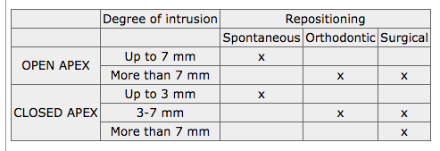
Intrusions
DIAGNOSIS
Tooth displaced into alveolar bone
High, metallic sound (ankylotic) to percussion and usually immobile
Pulp testing – usually -ve.
Radiographically PDL space may be absent entirely/partially, CEJ more apical to adjacent teeth
TREATMENT
Spontaneous re-eruption: immature teeth or very minor injuries for mature teeth → initiate ortho/surgical movement after 2-4 weeks of no movement to prevent ankylosis
Orthodontic repositioning: enables socket repair due to slow tooth movement, after tooth is repositioned use flexible splint for up to 4/52 (3-7mm)
Surgical repositioning: preferable in acute phase, major intrusions
Place flexible splint after repositioning for 4 weeks (if repositioned)
Closed apex, tooth will likely become necrotic, RCT with temporary CaOH medicament recommended (start 2-3 weeks after repositioning)
Review: 2 weeks, 4 weeks, 6-8 weeks, 6 months, 1 year, yearly for 5 years
PATIENT INSTRUCTIONS
Soft food: 7-10 days
Good OH: brush with a soft toothbrush after every meal, 0.1% CHx gel topically bds 1/52

Slide 18
Avulsions
At scene of the tragedy:
Ensure it is a permanent tooth (primary teeth should not be replanted)
Keep patient calm
Pick up tooth by the crown, do not touch the root
If tooth is dirty wash briefly (10 sec) under cold running water and reposition → encourage patient/parent to reposition, bite on handkerchief to hold it in position
If repositioning on site not possible store tooth in appropriate storage medium (goal = preserving viability of PDL cells)
HBSS
Saline
Saliva (I/O or E/O)
AVOID storage in water
Seek emergency dental treatment immediately

Slide 19
Avulsions (Closed Apex)
Tooth replanted prior to arrival at clinic
Treatment
Clean the area with water, saline, or CHx
Suture gingival lacerations
Verify normal position of tooth clinically + radiographically
Flexible splint for 2 weeks
Systemic antibiotics 7 days (tetracycline first choice, Pen V for children under 12)
If tooth was in contact with soil and tetanus status uncertain → refer to GP for tetanus booster
RCT 7-10 days (before removal of splint) → use long term intra canal medicament (CaOH – 1 month, Odontopaste 2 weeks)
Review: 2 weeks, 4 weeks, 3 months, 6 months, 1 year, yearly thereafter (basically forever)
Patient Instructions:
- Avoid contact sports
- Soft foods for up to 2 weeks
- Brush teeth with soft toothbrush after each meal
- Use 0.1% CHx mouthrinse bds for 1 week

Slide 20
Avulsions (Closed Apex)
E/O Dry time less than 60 mins
Treatment
1) Clean root surface and apical foramen with stream of saline + soak tooth in saline (remove contamination + dead cells from root surface)
2) Give LA
3) Irrigate socket with saline
4) Examine socket for alveolar fracture, reposition fractured segment
5) Replant tooth with slight digital pressure
6) Suture gingival lacerations
6) Verify normal position of tooth clinically + radiographically
7) Flexible splint for 2 weeks
8) Systemic antibiotics 7 days (tetracycline first choice, Pen V for children under 12)
9) If tooth was in contact with soil and tetanus status uncertain → refer to GP for tetanus booster
10) RCT 7-10 days (before removal of splint) → use long term intra canal medicament (CaOH – 1 month, Odontopaste 2 weeks)
11) Review: 2 weeks, 4 weeks, 3 months, 6 months, 1 year, yearly thereafter (basically forever)
Patient Instructions:
- Avoid contact sports
- Soft foods for up to 2 weeks
- Brush teeth with soft toothbrush after each meal
- Use 0.1% CHx mouthrinse bds for 1 week

Slide 21
Avulsions (Closed Apex)
E/O Dry time more than 60 mins
Treatment
1) Remove attached non-viable soft tissue carefully with gauze (can soak in 2% NaF for 20mins)
2) RCT can be done before replantation or 7-10 days after replantation
3) Give LA
4) Irrigate socket with saline
5) Examine socket for alveolar fracture, reposition fractured segment
6) Replant tooth with slight digital pressure
7) Suture gingival lacerations
8) Verify normal position of tooth clinically + radiographically
9) Flexible splint for 4 weeks
10) Systemic antibiotics 7 days (tetracycline first choice, Pen V for children under 12)
11) If tooth was in contact with soil and tetanus status uncertain → refer to GP for tetanus booster
12) RCT 7-10 days (or before replantation) → use long term intra canal medicament (CaOH – 1 month, Odontopaste 2 weeks)
13) Review: 4 weeks, 3 months, 6 months, 1 year, yearly thereafter (basically forever)
Patient Instructions:
- Avoid contact sports
- Soft foods for up to 2 weeks
- Brush teeth with soft toothbrush after each meal
- Use 0.1% CHx mouthrinse bds for 1 week
*poor long term prognosis with this scenario, goal is to maintain tooth short term for aesthetics, function, and psychological health + to maintain bone contour however ankylosis and root resorption is the expected eventual outcome

Slide 22
Avulsions (Open Apex)
Tooth replanted prior to arrival at clinic
Treatment
Clean the area with water, saline, or CHx
Suture gingival lacerations
Verify normal position of tooth clinically + radiographically
Flexible splint for 1-2 weeks
Systemic antibiotics 7 days (tetracycline first choice, Pen V for children under 12)
If tooth was in contact with soil and tetanus status uncertain → refer to GP for tetanus booster
Avoid RCT initially, if revascularisation fails and tooth becomes necrotic, perform RCT
Review: 2 weeks, 4 weeks, 3 months, 6 months, 1 year, yearly thereafter (basically forever)
Patient Instructions:
- Avoid contact sports
- Soft foods for up to 2 weeks
- Brush teeth with soft toothbrush after each meal
- Use 0.1% CHx mouthrinse bds for 1 week
Signs of pulpal necrosis:
Negative response to pulp testing after at least 6 weeks
Development of classic signs re: PA R/L, TTP, draining sinus
Development of inflammatory root resorption (internal or external)

Slide 23
Avulsions (Open Apex)
E/O Dry time less than 60 mins
Treatment
Clean root surface and apical foramen with stream of saline
Soak tooth in saline + antibiotics for 5 mins, 1mg doxycycline per 20 ml saline (increases chances of revascularisation)
3) Give LA
4) Irrigate socket with saline
5) Examine socket for alveolar fracture, reposition fractured segment
6) Replant tooth with slight digital pressure
7) Suture gingival lacerations
8) Verify normal position of tooth clinically + radiographically
9) Flexible splint for 2 weeks
10) Systemic antibiotics 7 days (tetracycline first choice, Pen V for children under 12)
11) If tooth was in contact with soil and tetanus status uncertain → refer to GP for tetanus booster
12) Avoid RCT initially, if revascularisation fails and tooth becomes necrotic, perform RCT
13) Review: 2 weeks, 4 weeks, 3 months, 6 months, 1 year, yearly thereafter (basically forever)
Patient Instructions:
- Avoid contact sports
- Soft foods for up to 2 weeks
- Brush teeth with soft toothbrush after each meal
- Use 0.1% CHx mouthrinse bds for 1 week

Slide 24
Avulsions (Open Apex)
E/O Dry time more than 60 mins
Treatment
1) Remove attached non-viable soft tissue carefully with gauze (can soak in 2% NaF for 20mins)
2) RCT can be done before replantation or 7-10 days after replantation
3) Give LA
4) Irrigate socket with saline
5) Examine socket for alveolar fracture, reposition fractured segment
6) Replant tooth with slight digital pressure
7) Suture gingival lacerations
8) Verify normal position of tooth clinically + radiographically
9) Flexible splint for 4 weeks
10) Systemic antibiotics 7 days (tetracycline first choice, Pen V for children under 12)
11) If tooth was in contact with soil and tetanus status uncertain → refer to GP for tetanus booster
12) RCT 7-10 days (or before replantation) → use long term intra canal medicament (CaOH – 1 month, Odontopaste 2 weeks)
13) Review: 4 weeks, 3 months, 6 months, 1 year, yearly thereafter (basically forever)
Patient Instructions:
- Avoid contact sports
- Soft foods for up to 2 weeks
- Brush teeth with soft toothbrush after each meal
- Use 0.1% CHx mouthrinse bds for 1 week
No attempt made at revascularization made here because of poor long term prognosis, efforts made at delaying the inevitable

Slide 25
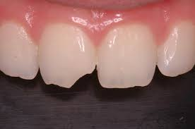
Uncomplicated fractures
Enamel and dentine fractures
DIAGNOSIS
Check for tooth fragment
Nil TTP, normal mobility
Pulp testing usually positive
Radiographically normal, can visualise fracture usually (look out for presence of root fracture or associated luxation injury)
TREATMENT
Smoothening, rebond tooth fragment, restoration
Radiograph of lip/cheeks to check for missing fragments
Follow-up: 6-8 weeks, 1 year

Slide 26
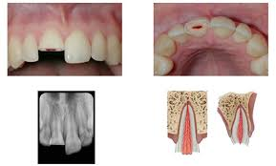
Complicated fractures
DIAGNOSIS
Check for tooth fragment
Nil TTP, normal mobility
Pulp testing - usually +ve, if -ve usually poor sign (increased risk of necrosis)
Radiographically check for signs of displacement or root fracture
Lip radiograph for signs of tooth fragments/foreign bodies
TREATMENT
If possible, preserve vital pulp (both open and closed apices)
Direct pulp capping - clean and disinfect, place place Ca(OH)2 or MTA, restore coronally (must have good seal)
Partial pulpotomy - remove 2mm of pulp tissue, apply saline cotton pellet until HA, place Ca(OH)2 or MTA, restore coronally (must have good seal)
Root canal treatment (closed apex with associated luxation and displacement)
Radiograph of lip/cheeks to check for missing fragments
Follow-up: 6-8 weeks 1 year

Slide 27
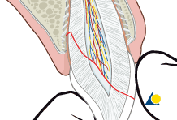
Subgingival fractures
DIAGNOSIS
Crown fracture extending subgingivally, may/may not involve pulp. Tooth is split into 2+ fragments, one of which is mobile
Tenderness to percussion, at least one coronal fragment mobile, may have increased pain due to mobility
Pulp testing - usually +ve for apical fragment
Radiographically apical sign of fracture usually not visible
TREATMENT
Fragment removal (small), restore coronally
Remove coronal segment, complete RCT, restore with post-core crown. Should be preceded with gingivectomy, ostectomy/osteoplasty. Only suitable with palatal subgingival extensions.
Orthodontic extrusion, placement of crown (implies RCT)
Surgical extrusion: remove mobile fragment, subsequently reposition root coronally, root rotation 90 to 180 degrees may offer better healing, extirpate and apply flexible splint. RCT can be commenced after 4 weeks.
Decoronation: postpones definitive restoration but preserves alveolar bone (implants)
Extraction
Follow-up: 6-8 weeks, 1 year

Slide 28
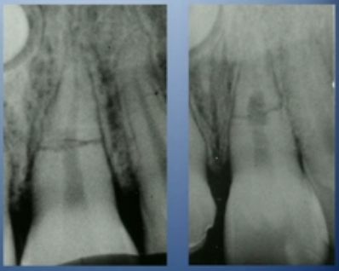
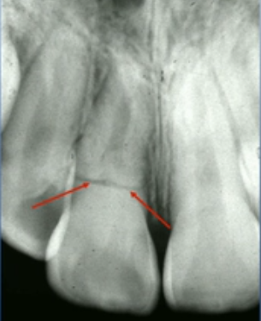
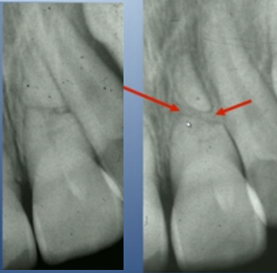
Horizontal root fracture
DIAGNOSIS
Horizontal root fractures can be in the apical, middle, coronal third
Coronal third has the poorest prognosis: most prone to bacterial contamination
Coronal segment may be mobile/displaced
Bleeding from sulcus may be present
Sensibility testing may be negative initially, monitor this
Transient discoloration may occur (red-gray)
Find fracture with normally angulated PA, PAs with varying vertical angles, or occlusal films
PATTERNS OF HEALING
Maintenance of cementum is essential: otherwise replacement resorption occurs
Reparative hard tissue
Interposition of fibrous CT
Interposition of fibrous CT and bone
TREATMENT
Reposition coronal segment if displaced
Check position radiographically
Flexible splint 4 weeks (fracture in cervical area = splint for up to 4 months)
Monitor pulpal status → necrosis = RCT till fracture line
Followup: 4 weeks, 6-8 weeks, (4 months), 6 months, 1 years, yearly for 5 years

Slide 29
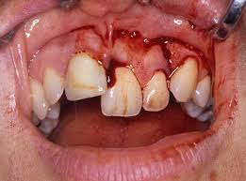
Alveolar fractures
DIAGNOSIS
Displacement of alveolar segment, occlusal change due to misaligned segment
Tender to percussion, entire segment mobile, moves as unit
Pulp testing – may be negative
Occlusal change due to misalignment of fractured segment common
Radiographically check with 3 angulations, occlusal view, and OPG → vertical line may run along PDL/septum, horizontal line may be located at any level. Gives valuable information about risk of damage to permanent tooth germs in children.
TREATMENT
Manual repositioning under LA or use forceps (GA may be required in children)
Suture gingival lacerations
Apply flexible splint for 4 weeks
Follow-up: 4 weeks, 6-8 weeks, 4 months, 6 months, 1 year, every year for 5 years
PATIENT INSTRUCTIONS
Soft food: up to 2 weeks
Good OH: brush with a soft toothbrush after every meal, 0.1% CHx gel topically bds 1/52

Slide 30
Management of Trauma in Primary Teeth
Main Goal = To minimise damage to permanent successor tooth

Slide 31
Concussion
DIAGNOSIS
Tooth is TTP, nil displacement or mobility
Radiographically normal appearance
TREATMENT
Not needed
Clinical followup 1 week, 6-8 weeks (nil radiographs required)

Slide 32
Subluxation
DIAGNOSIS
No displacement, but TTP and increased mobility
Bleeding from sulcus may be evident
Radiographically normal appearance
Occlusal radiograph recommended → check for displacement/root fracture, serves as baseline
TREATMENT
Not needed, monitor
Clinical followup: 1 week, 6-8 weeks
OHI: Brush area with soft toothbrush + apply 0.12% CHx gel with cotton bud 2/day for 1 week

Slide 33
Extrusion
DIAGNOSIS
Tooth partially displaced from socket
Tooth appears elongated, mobility ++,
Radiographically increased PDL space apically
TREATMENT
* Based on degree of displacement, mobility, root formation, and coping ability of child
If minor (<3mm), immature developing tooth: careful reposition/leave for spontaneous realignment
If severe, fully formed permanent tooth = extraction
Follow-up: 1 week, 6/8 weeks, 6 months, 1 year (radiographs at 6/8 weeks, 6 months, 1 year)
Tooth may become discoloured, monitor discoloured teeth for signs of infection (eg. draining sinus, loss of bone at furcation)

Slide 34
Lateral Luxation
DIAGNOSIS
Tooth displaced palatally or labially
Nil mobility
Occlusal radiograph: increased PDL space, position of displaced tooth in relation to permanent successor
TREATMENT
No occlusal interference (eg. Anterior open bite) → Spontaneous repositioning
Minor occlusal interference → minor occlusal adjustment
More severe occlusal interference → gentle repositioning under LA
Severe displacement → extraction
Followup: 1 week, 2-3 weeks, 6-8 weeks, 1 year (radiographs at 6-8 weeks, 1 year)

Slide 35
Intrusion
DIAGNOSIS
Tooth displaced through labial bone plate or can be impinging on permanent tooth bud
Radiographs: if displaced through labial bone, can visualise apical tip + tooth appears shorter than contralateral, if impinging on permanent tooth bud the apical tip cannot be visualised and the tooth appears elongated
TREATMENT
Apex displaced towards labial bone plate = spontaneous repositioning
Apex displaced towards permanent tooth germ = extract
Follow up: 1 week, 3-4 weeks, 6-8 weeks, 6 months, 1 year or until permanent tooth erupts (radiographs start at 3-4 weeks)

Slide 36
Avulsion
DIAGNOSIS
Pretty straightforward
TREATMENT
Do not replant primary teeth
Followup 1 week, 6 months, 1 year (or until permanent tooth erupts)

Slide 37
Uncomplicated Fracture
DIAGNOSIS
Fracture involving enamal and dentine, nil pulpal involvement
TREATMENT
Smooth sharp edges, seal dentine with GIC, restore with CR
Clinical followup in 3-4 weeks

Slide 38
Complicated Fracture
DIAGNOSIS
Check for tooth fragment
Radiographically check for stage of root development
TREATMENT
If possible, preserve vital pulp by partial pulpotomy (depends also on pt’s ability to cope)
Partial (Cvek) pulpotomy - remove 2mm of pulp tissue, apply saline cotton pellet until HA, place Ca(OH)2 or MTA, restore coronally (must have good seal)
Otherwise Extraction
Radiograph of lip/cheeks to check for missing fragments
Follow-up: 1 week, 6-8 weeks, 1 year

Slide 39
Subgingival fractures
DIAGNOSIS
Crown fracture extending subgingivally, may/may not involve pulp. Tooth is split into 2+ fragments, one of which is mobile
Tenderness to percussion, at least one coronal fragment mobile, may have increased pain due to mobility
Radiographically apical sign of fracture usually not visible, if lateral fracture check with relation to gingival margin
TREATMENT
Depends on extent of fracture→ fragment removal or extraction
Pulpal involvement: partial pulpotomy, extraction
Followup: 1 weeks, 6-8 weeks, 1 year

Slide 40
Horizontal root fracture (primary)
DIAGNOSIS
Coronal segment usually mobile
Tooth possibly tender to percussion
PA or occlusal radiograph
TREATMENT
If coronal segment not displaced = no treatment
If coronal segment mobile = extract and leave apical segment to be resorbed
Follow-up: 1/52, 6-8/52, 1 year
PATIENT INSTRUCTIONS
Soft food: 10-14 days
Good OH: brush with a soft toothbrush after every meal, 0.1% CHx gel topically bds 1/52
Monitor for signs of pulpal pathosis

Slide 41
Alveolar Fractures (Children)
DIAGNOSIS
Fractures that involve alveolar bone may involve adjacent bones
Segment mobility/dislocation + occlusal interferences common
TREATMENT
GA often indicated
Reposition displaced segment, splint for 4 weeks
Monitor teeth associated with fracture
Followup: 1 week, 3-4 weeks, 6-8 weeks, 1 year (or until permanent tooth erupts)

Slide 42
Questions?

