Slide 1
BDS III – Oral Pathology and Dental Materials

Slide 2
Dental Materials

Slide 3
Hybrid layer formation – GIC vs. Resin-based adhesion
GIC-based adhesion
Resin-based adhesion
A shallow ION EXCHNAGE
True chemical adhesion
Biocompatible and H release
Can trap air – stress points in material
Diffusion of resin into intertubular dentine provides micro-mechanical retention
With wet bonding – water blisters can form at the primer-dentine interface
Monomer globules separate from acetone solvent (carrier)
Globules can block/prevent primer from forming resin tags → compromises bond strength

Slide 4
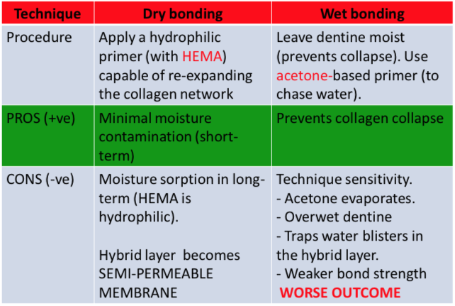
Resin-based adhesion - Wet vs. dry bonding

Slide 5
Generations of adhesive systems
4th generation – ‘Three-step’ system
Etch, primer, adhesive resin
5th and 6th generation – ‘Two-step’ system
Self etching primer
Primer/adhesive resin
Less micromechanical strength - inferior to three step system
7th generation adhesive – ‘all in one ‘ system

Slide 6
Two-step vs. All-in-one systems
Two step (5th and 6th generation)
Etch and rinse (adhesion)
When water concentration is >25%, phase separation occurs at the dentine-resin interface
Problems with etch and rinse adhesion
Incomplete infiltration of primer into demineralized collagen
Long-term water sorption into the hybrid layer – due to HEMA
Problems with self-etch adhesives
Formation of water blisters
Semi-permeable membranes
Greater failure rate and poorer bonding strengths than etch-and-rinse adhesives
All in one (7th generation)
Water trees

Slide 7
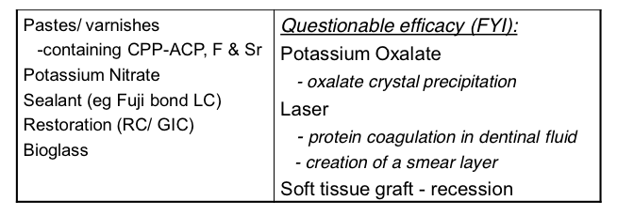
Dentinal hypersensitivity
Presentation – erosion, attrition, abrasion for combination of both
Patient presenting with hypersensitivity – has to have erosion in conjunction with either attrition of abrasion – smear layer created and dentinal tubules occluded with attrition or abrasion alone
Management and diagnosis of patient with dentinal hypersensitivity – ADDRESS CAUSATIVE FACTORS FIRST.
Types of products available for patient presenting with erosion – what are they made of, mechanisms of action

Slide 8
Products used for hypersensitivity
CPP-ACP (tooth mousse) and CPP-ACFP (tooth mousse plus)
Fluoride
Enamel varnish (CaF2) – forms CaF2 globules on tooth surface at neutral pH which occludes dentinal tubules – role in hyper-mineralisation as CaF2 globules – form HA in acidic pH
Stannous Fluoride – occludes dentinal tubules by precipitation of calcium fluoride crystals – therefore stimulation of mechanoreceptors does not occur
Potassium nitrate (Sensodyne)
Contains KNO3 – high concentration of K+ ions outside the nerve membrane blocks the repolarisation phase of the action potential – therefore blocks plain impulses
Sealant (Fuji Bond LC, dentine hybridization)
Restoration (RC/GIC)
Bio-glass (SiO2, CaO, Na2O, P2O5, MgO
Bioglass interacts with saliva
Ca2+, PO43-, Si4+ dissolution at the glass interface – precipitation of hydrates Si-gel occurs, Si-gel is a template for formation of CaPo4 which crystalises into HA
Arginine (Pro-Argin)
Contains calcium carbonate and arginine (naturally found in saliva)
Arginine and calcium carbonate bind to the dentine surface – this attracts a calcium rich layer into the dentine tubules which occludes them
The layer resists acids

Slide 9
ORAL PATHOLOGY

Slide 10
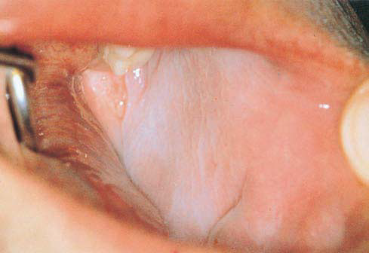
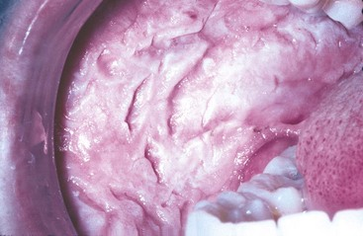
Developmental Lesions (Epithelial)
Leukodema
Common lesion, predominantly found in people with dark complexion, asymptomatic, bilateral, white-grey translucent, poorly defined margins
Pt. appears with lesion of similar/same appearance, what’s your DDx?
What is a key diagnostic characteristic of Leukodema?
White Sponge Naevus
Rare, autosomal dominant, varied expression, early onset, florid and obvious white lesion, poorly defined borders, can extend to subLi mucosas.
Why is it not a true nevi?
DDx? What characteristic/s would make you lean more towards this, than other lesions from your DDx?
Others: Fordyce Spots

Slide 11
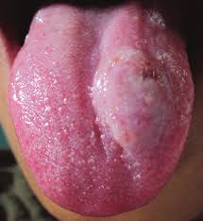
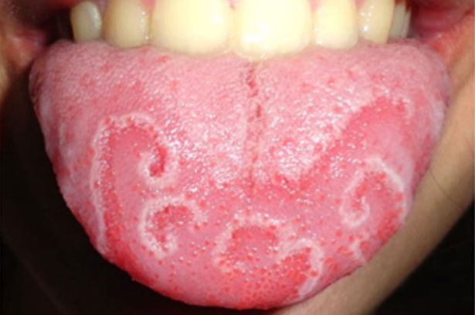
Developmental Lesions (CT)
Gingival Fibromatosis
Uncommon, painless enlargement, syndromic/idiopathic, no inflam, difficult to chew, ortho problems, slow progression
DDx? How would you differentiate this from drug or disease associated enlargement?
Haemangioma
Localised, vascular, congenital or assoc’ed w/ AVM, singular/multiple (syndromic), central/peripheral, red/purple bulbous lesion
How would you manage this? DDx? What is a key diagnostic characteristic of Haemangioma?
Lymphangioma
Rare, macroglossia, histo similar to cavernous BVs w/o RBCs
Others: Fordyce, Li Thyroid, Geographic tongue, Melanotic, Pigmented Naevi

Slide 12
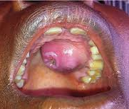
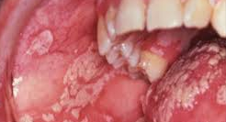
Oral Bacterial & Fungal Diseases
Syphilis (bacteria)
Acquired/congenital (Hutchinson’s incisors, Mulberry molars + Saddle deformity), Primary Chancre, secondary mucous patches, latent no symptoms but +ve serology, tertiary gumma and/or glossitis
A(NUG) (bacteria)
?genetic predisposition?, immunosuppression, painful necrosis, ulcerations and sloughing of gingiva, sudden onset, halitosis, inflamed CT
Cancrum Oris – sequelae to NUG, seen in children, severe localised destruction of soft and hard tissue
Actinomycosis (bacteria)
Infection from commensal bacteria, multiple foci of chronic suppuration, ‘lumpy jaw’, subMand region, variable pain
Candida (Fungal)
Poor hygiene, RVD, meds, Acute/Chronic, Atrophic/Hypertrophic/Hyperplastic, stomatitis, thrush, median rhomboid glossitis, angular chelitis
DDx? How can you differentiate?

Slide 13
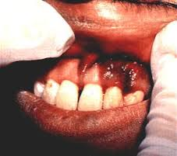
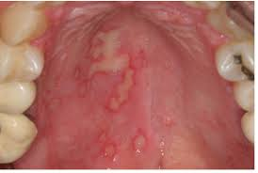
Oral Viral Diseases
Localised Diseases
HSV – 1&2, VZV (shingles), EBV (oral hairy leukoplakia), HHV8 (Kaposi’s Sarcoma), Cytomegalovirus, HPV, Coxsackie (Herpangina)
Systemic Diseases
VZV (chickenpox), EBV (Burkitt’s Lymphoma, Nasopharyngeal Carcinoma), Morbillivirus (measles), Paramyxovirus (mumps), HIV, Hep C
Assoc’ed w/ HIV
EBV, HSV, HPV, VZV, ANUG, Neoplastic Disease (Kaposi’s Sarcoma, Non-Hodgkin’s Lymphoma, SCC)

Slide 14
Commonwealth of Australia
Copyright Regulations 1969
Warning
This material has been reproduced and communicated to you by or on behalf of The University of Adelaide under Part VB of the Copyright Act 1968 (the Act).
The material in this communication may be subject to copyright under the Act. Any further reproduction or communication of this material by you may be the subject of copyright protection under the Act.
The AUDSS assumes no responsibility or liability for any information, materials or other content provided by any of our student lecturers. All content is viewed and used by you at your own risk and we do not warrant the accuracy or reliability of any of the lecture material.
The views expressed are those of the individual contributors and not necessarily those of the AUDSS of Adelaide School of Dentistry.
Do not remove this notice.

